Slide 1


EasyMed Classification and routing of patients to emergency medical centers

Slide 2
3.2 Hours
Average time for waiting in Eemergency room
Notes:
https://www.ynet.co.il/health/article/hyidzmojy -according to 2019 and 2020

Slide 3
The Problem
The collapse of emergency rooms in hospitals due to the arrival of patients with a problem that could be treated in other centers

Slide 4
The Solution
Step 1
Step 2
Step 3
An Internet service that directs a patient to the most available Er center that meets his needs, using AI to manage and optimize the routing process.
Get the patient’s location
Define the medical issue
Point me to the most suitable Er center

Slide 5
SO..
How does it Work?

Slide 6
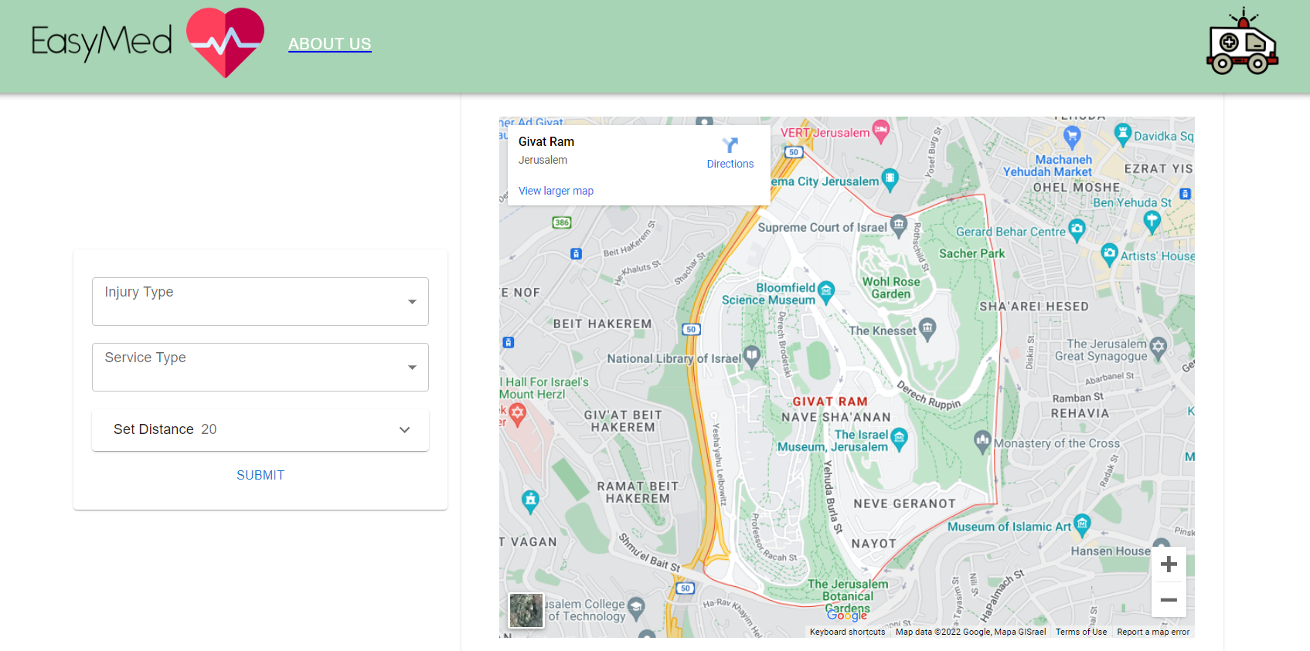

Slide 7
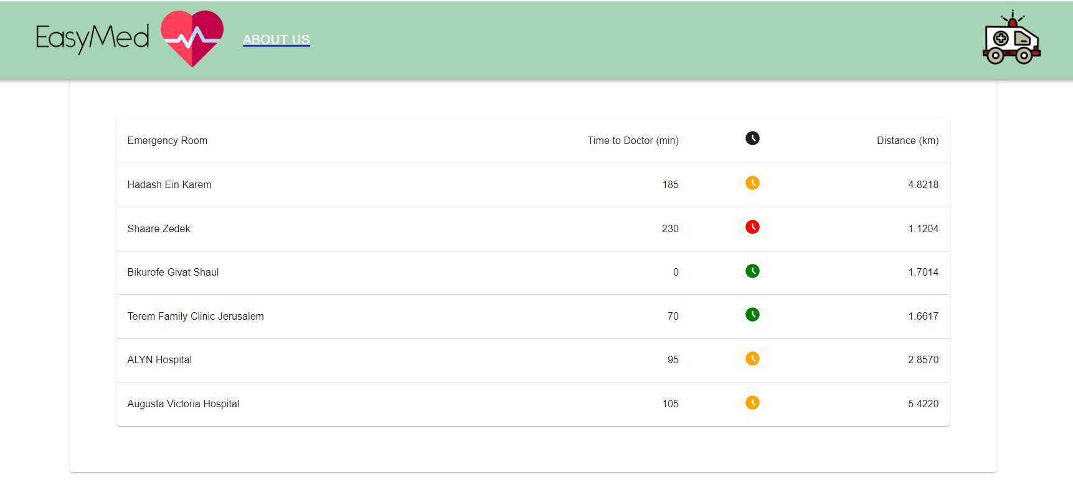

Slide 8
Competitive Landscape
Israeli Ministry of Health
Worldwide
By primary search, We haven’t found any relevant solutions worldwide.
Presented the project- “Waze of emergency rooms” in 2016, but due to now, it’s not been activated.

Slide 9
Business Model
01
02
03
Costumers
Collaborations
Extensions
Our main customer is the health insurer for Israeli citizens
Collaboration with the Israeli Ministry of Health and public hospitals
Extension to health services applications

Slide 10
Challenges
Challenge | Solution
Access to a technologically challenged population | A simple user interface connected to the medical service applications
Changing patients' habits | our product allows the customer to significantly reduce waiting times
Difficulty in conducting a pilot since most of the population rarely gets to Er | Selecting people for the pilot who visit the Er frequently

Slide 11





OUR TEAM
Amoss Dvir
Omer Beeri-Shani
Ore Snir
Yonatan Sugerman
Amir Kelman

Slide 12
THANKS!
Do you have any questions?
amir@easymed.com
easymed.com

